Slide 1
Wordle Match
Team 1 – Ayush Venkatesh, Olasunkanmi Olayinka, Sai Sumana Puppala, Jared Girouard

Slide 2
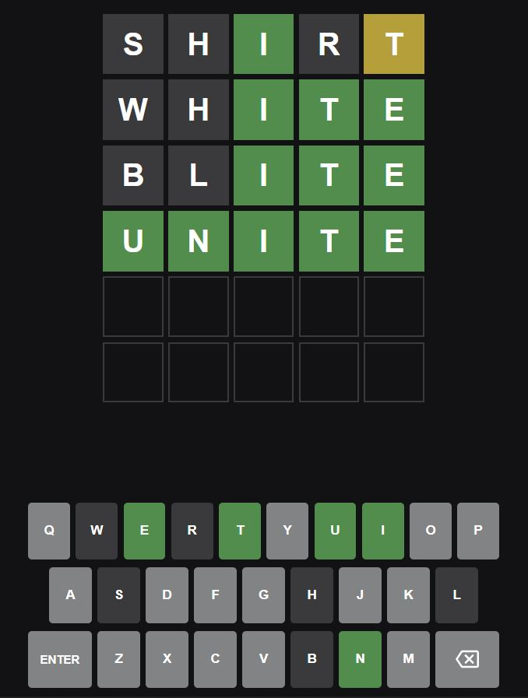
Wordle
5-letter word
6 guesses
No color – letter not in word
Yellow – letter in word but wrong position
Green – letter in word in correct position

Slide 3
Use Cases
System queries wordle tweets twice each day.
System generates user clusters of expertise levels, for a given day.
Top N User Search
Given a user, provide top n users with similar game pattern results over a date/range.
On a given day, compute user rankings based on scores.

Slide 4


Methodology
Data Collection and Analysis
Extract wordle game results of users from Twitter API, over a period.
Clean and transform data to get 5*6 pattern matrices of game results.
User Match
Compute user similarity scores among user game result matrices using a distance metric.
Dashboards
Build dashboards to portray user clusters, rankings and top n similar users.

Slide 5

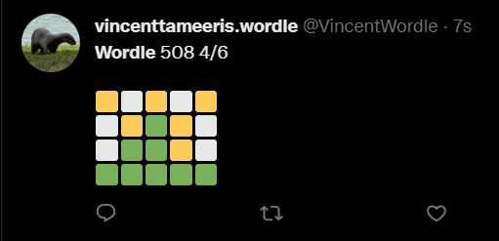
Data Sources
The following data will be extracted via Twitter API:
User who posted the tweet
Wordle score
Date/Time
Initially targeting 1 million rows of data
Free API limits number of tweets

Slide 6
Milestones
Sprint 1 (11/6–11/12): Define requirements and create repository
Sprint 2 (11/13 – 11/19): Data collection
Sprint 3 (11/20 – 11/26): Data collection and data cleaning
Sprint 4 (11/27 – 12/3): Data visualization
Sprint 5 (12/4 – 12/10): Finalize Data visualization

Slide 7
Use of Scala
Extraction of data to be done using the Scala twitter API, found here: https://index.scala-lang.org/alexdupre/twitter-scala
Data preprocessing and transformation.
Spark to parallelly compute user similarity scores.
User defined functions to be created to calculate metrics such as similarity scores among users.
Visualization libraries to be used to display data graphically.

Slide 8
Goals
Demonstrate uses of Scala and Spark by creating an end-to-end project that extracts, transforms and visualizes data from an API.
Create a similarity matrix among all users that shows how similar a player's wordle attempts were to other players.
Display the top n performing players graphically.
(If time permits) Create graphs of commonly occurring words.

Slide 9
Acceptance Criteria
Check if 1 million rows are extracted.
User search response in 5 seconds.
Choose an appropriate distance metric that gives a similarity score of at least 75% in the range of a base metric.
Data is extracted twice a day.

